Slide 1
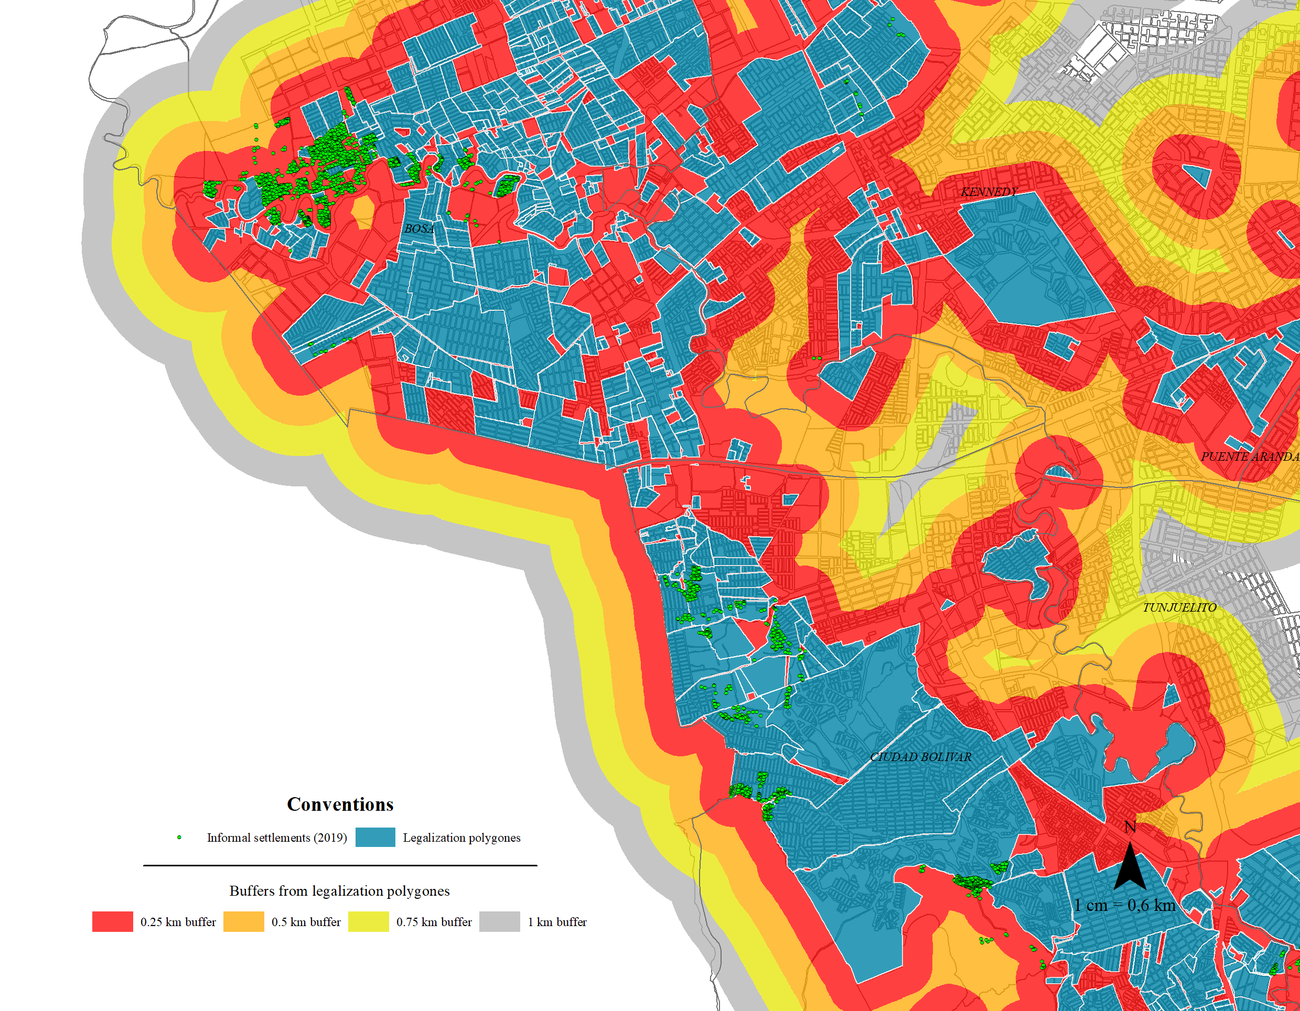


Slum recognition effects on urban informal expansion:
An impact evaluation of the Neighborhood Legalization program in Bogotá, Colombia
Universidad del Rosario, 2022
Faculty of economics
Guibor Camargo
https://github.com/Guibi1994/Neighborhood_Legalization

Slide 2
Introduction
Urban expansion is one of the most important events in South America’s recent history. In the case of Bogotá, the urban population almost doubled in the last 3 decades (DANE,1989,2005 and 2018), and up today is the 46th most dense urban area in the world
Due to various factors, such as economic transitions, lack of respond by local and national authorities, natural catastrophes and the internal conflict, most of this growth have mostly consisted in the expansion of slums (the informal city) (Camargo et al. 2020).
The last have generating an important issue in terms of habitat: 3.8% of Bogota’s household are in quantitative deficit while 10.2% are in qualitative deficit (DANE 2018).
To overcome this challenge, Colombian authorities compounded all the urbanistic normative framework and urbanistic instruments inside the law 388 of 1994 , which give birth to the POTs (Planes de Ordenamiento Terrotiral). This urban plans, created programs and norms, to re-conduct the spontaneous sudden urban growth. Among this programs, there was the neighborhood legalization program.
The neighborhood legalization have consisted in recognizing informal/illegal settlements, so they can be letter could later be provided with public infrastructure and amenities, in contrast of solution based on constructing entirely new social housings.
Universidad del Rosario - Faculty of Economics
Guibor Camargo

Slide 3
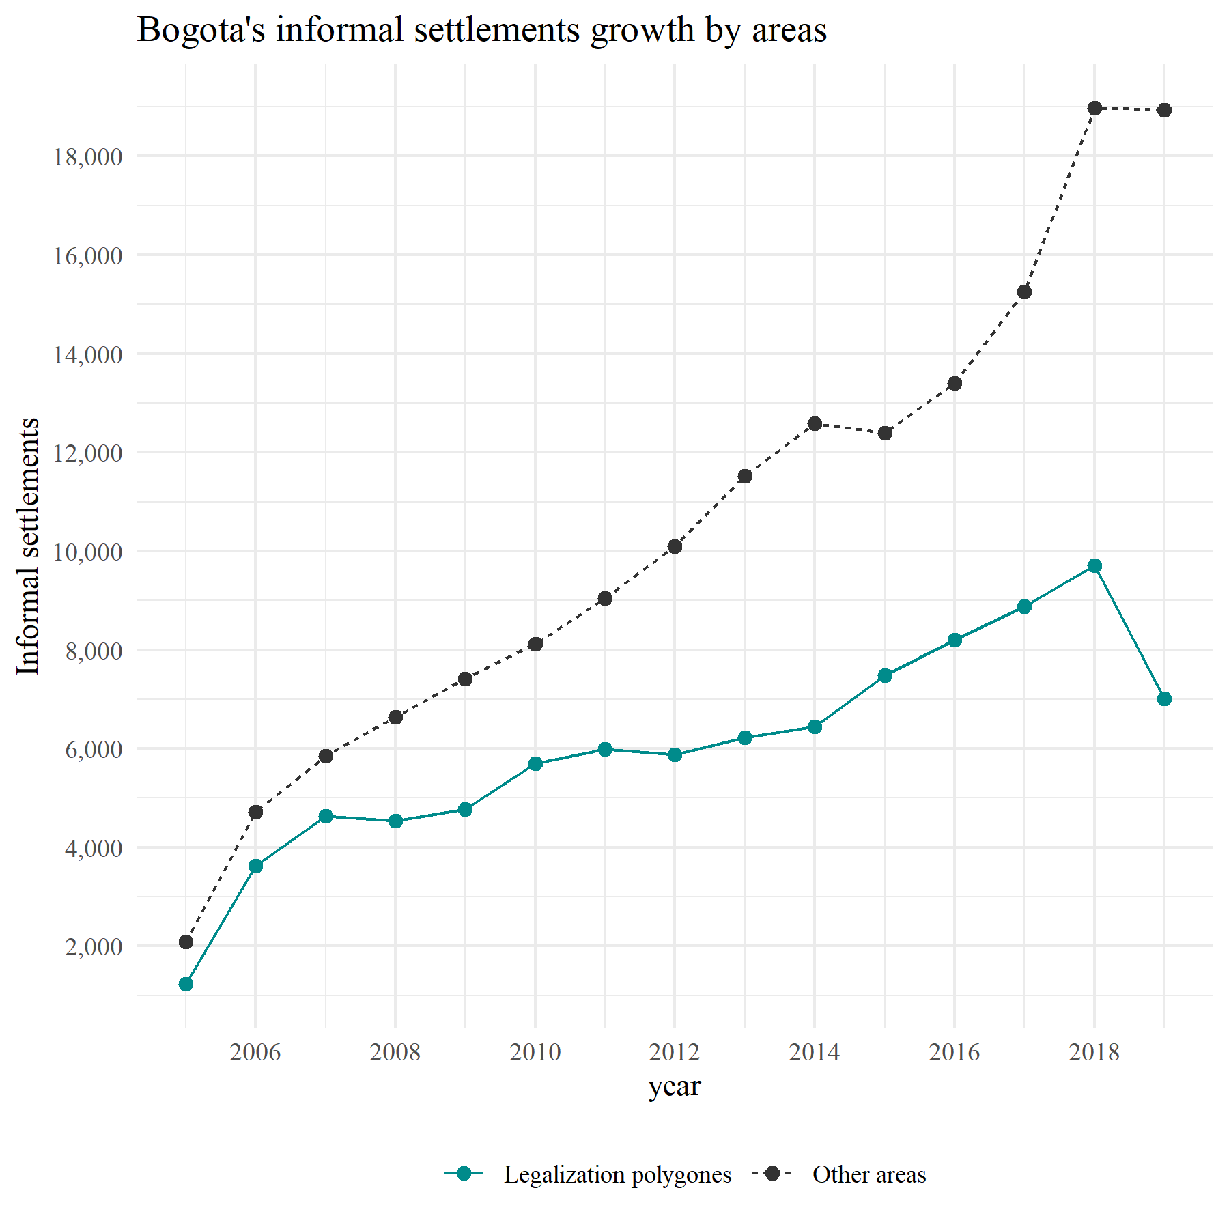
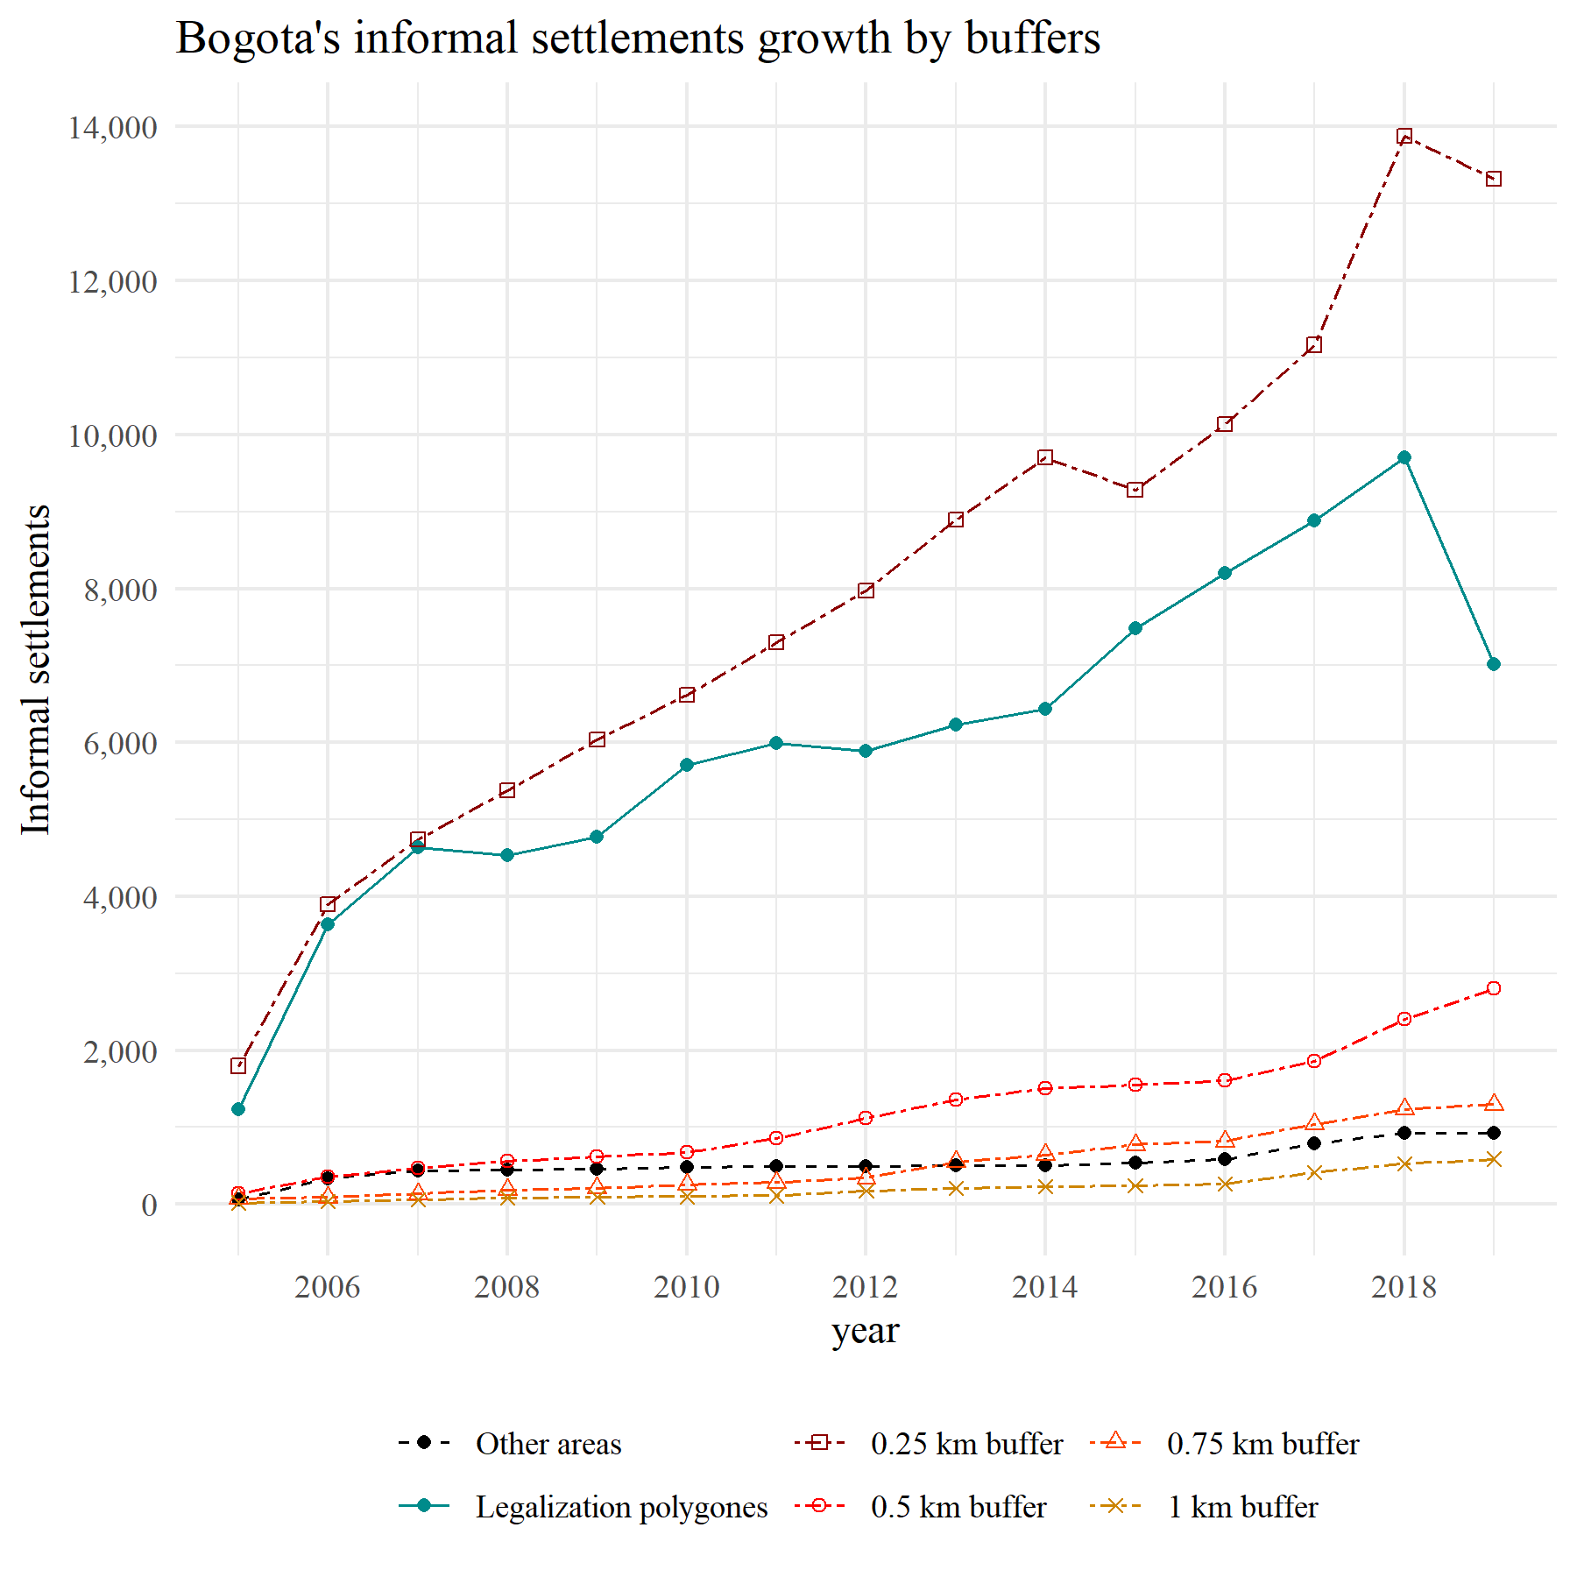
Introduction
Between the debate between formalization and formal construction, one of the main critiques towards legalization has been that it generates incentives to informal growth. Nevertheless, this question about whether legalization fosters informal growth or not, remains unknown.
Universidad del Rosario - Faculty of Economics
Guibor Camargo

Slide 4
Introduction
Does the neighborhood legalization program have an effect on informal growth?
International studies
Salud:
Turley, R., et al 2013: Reduction of water-related diseased.
Henson, R. M., et al. 2020: Evidence of positive health effects, including those of housing on quality of life and communicable diseases.
Economía:
Casas, 2018: Dif-Dif, based on 8 neighborhoods in Nicaragua. Positive effects on housing quality, security perception and creation of new business.
Akie Takeuchi, et al. 2008: Mumbai, neighborhood improvement program had effects on rent, but depending on general connectivity.
Majale, M. 2008. Analyzes how these programs can generate jobs in informal neighborhoods
Local studies:
Nieto, C. A. B., et al 2012. founded significant effects of the Neighborhood improvement program over land prices (just in Bosa, Bogotá).
Corredor, C, 2020. also founded an increase in land prices, but derived from neighborhood legalization programs in Bogotá
The literature gap:
Most of the articles ignore city level effects, and in physical transitions more than legal changes.
Most of the research focuses on positive outcomes: most of the time on redundant and deterministic policy effects.
Most of the literature ignore the central philosophy of this policies: controlling the expansion to the informal/illegal city (the wellbeing/welfare fallacy)
Universidad del Rosario - Faculty of Economics
Guibor Camargo

Slide 5






Data
Neighborhood Legalization polygons with legal process info* (1950-2019)
Neighborhood Improvement program polygons* (2002-2019)
Resettlement Program points (2004-2019)
Informal constructions –SDH (2005-2019)
Formal constructions – ODC (2012-2019)
Census data (2005 and 2018)
Universidad del Rosario - Faculty of Economics
Guibor Camargo

Slide 6
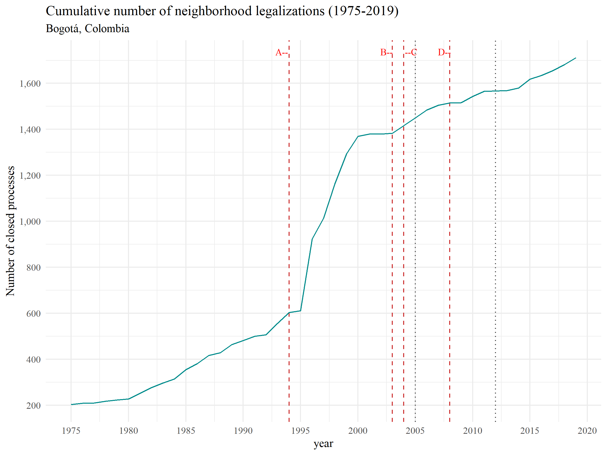
Context: the legalization program
Historical milestones:
.1994: The Law 388 gave to all municipalities the order to formulate their first POT’s.
.2003: President Alvaro Uribe Velez stablished in his Developing Plan that informal settlements which origin year were after 2003, could not be legalized nor receive any public investment. (VIS/VIP/Macro)
.2004: Bogotá finally (by decree) adopts its first POT (decree 190 of 2004).
.2008: The constitutional court declare the 2003 restriction against the constitution.
Universidad del Rosario - Faculty of Economics
Guibor Camargo

Slide 7
Context: articulation with other programs
New social housing programs
yes
Resettlement program (●)
no
“It’s on high-risk zones □?”
no
Neighborhood legalization program (□)
Lawsuit - “Tutela”
Illegal connections
“Is the settlement legal?”
District office of Habitat titling programs (●)
Public services
(aqueduct, sewerage, electricity, etc.)
“Does the settlement have available space for public infrastructure?”
Property Titling
yes
no
yes
Neighborhood improvement program (□)
Public infrastructure
(roads, parks, schools, etc.)
Regularization program (□)
Universidad del Rosario - Faculty of Economics
Guibor Camargo

Slide 8
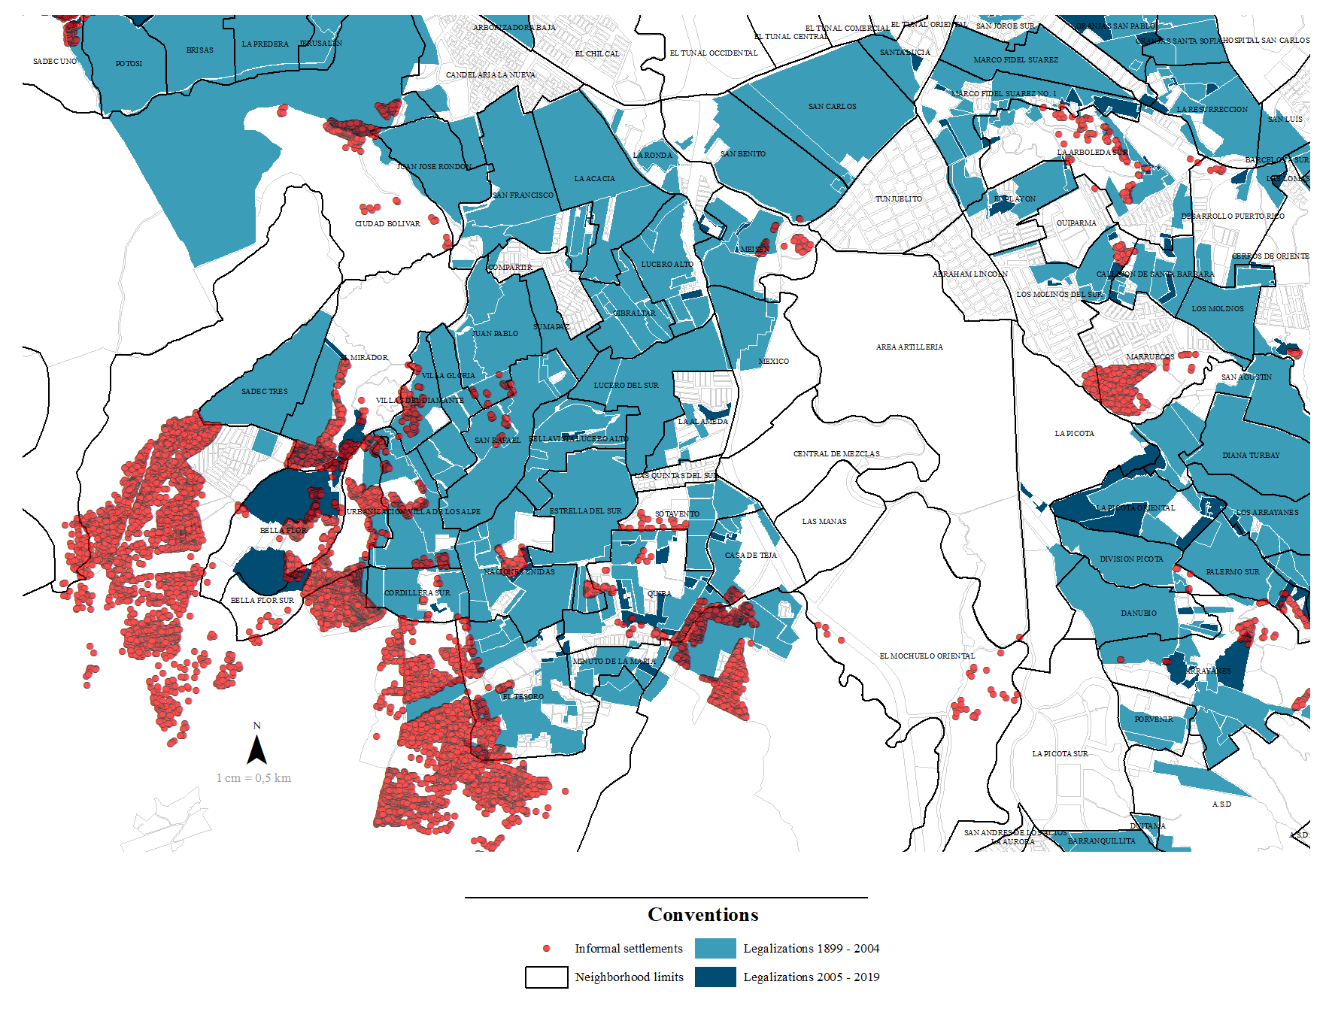
Empirical restrictions
Violación de SUTVA, geográfica y macro-teporalmente
Anticipación del tratamiento
Relación entre las variables dependientes principales y otros programas similares
No hay unidades “never-tretead”
Perdida del poder de comparación con el tiempo
Sin información de dependientes y covariables de la mayor parte del programa
Endogeneidad entre el tratamiento y la variable de efecto
Cambio en las condiciones del tratamiento (agua como derecho)
Sesgos de error de medición
Universidad del Rosario - Faculty of Economics
Guibor Camargo

Slide 9
Empirical strategy
$$ATT_{1}…$$
$$ATT_{2}…$$
$$ATT_{1}…$$
$$ATT_{2}…$$
i =1
W = 0.06
i =1
i =2
W = 0.12
i =2
Distancia (W)
Distancia (W)
i =3
W = 0.25
i =3
i =4
W = 0.50
i =4
i =5
T = -2
T = -1
T = 0
T = 1
T = 2
T = 3
T = 4
i =5
2010
2011
2012
2013
2014
2015
2016
2010
2011
2012
2013
2014
2015
2016
Año previo a ser legalizado (C = 1)
Buffer de x radio
Año de legalización (T = 1 / T = 0)
Año después de legalizado (T = 1 / T = 1+t)
Universidad del Rosario - Faculty of Economics
Guibor Camargo

Slide 10
Empirical strategy
i =1
i =2
$$ATT…$$
Distancia (W)
i =3
i =1
W = 0.06
i =4
i =2
W = 0.12
Distancia (W)
i =5
i =3
W = 0.25
2010
2011
2012
2013
2014
2015
2016
i =4
$$ATT…$$
W = 0.50
i =5
T = -2
T = -1
T = 0
T = 1
T = 2
T = 3
T = 4
$$ITT…$$
2010
2011
2012
2013
2014
2015
2016
i =1
i =2
Año previo a ser legalizado (C = 1)
Año de inicio del proceso de legalización
Distancia (W)
i =3
Año de legalización (T = 1 / T = 0)
Año entre el aviso y la ejecución
i =4
Año después de legalizado (T = 1 / T = 1+t)
i =5
2010
2011
2012
2013
2014
2015
2016
Universidad del Rosario - Faculty of Economics
Guibor Camargo

Slide 11
Empirical strategy
Universidad del Rosario - Faculty of Economics
Guibor Camargo

Slide 12
Results
Universidad del Rosario - Faculty of Economics
Guibor Camargo

Slide 13
Violación de SUTVA, geográfica y macro-teporalmente
Anticipación del tratamiento
No hay unidades “never-tretead”
Perdida del poder de comparación con el tiempo
Sin información de dependientes y covariables de la mayor parte del programa
Endogeneidad entre el tratamiento y la variable de efecto
Relación entre las variables dependientes principales y otros programas similares
Cambio en las condiciones del tratamiento (agua como derecho)
Sesgos de error de medición
i =1
i =2
i =3
i =4
i =5
2010
2011
2012
2013
2014
2015
2016
Polígono de legalización legalizado
Polígono de legalización aun no legalizado
Legalizado

